Slide 1
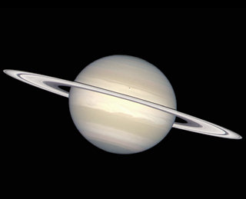
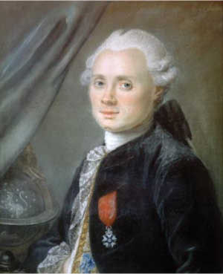
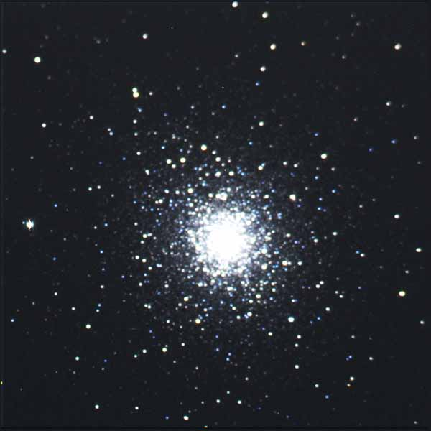
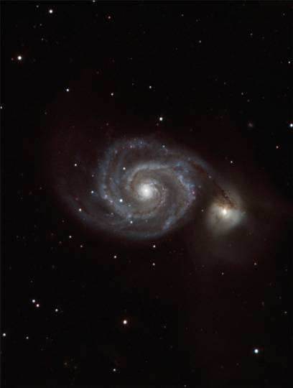
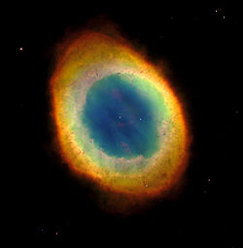
Messier Album

Slide 2
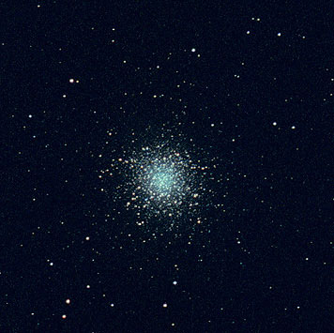
M13 Through the Telescope
M13 is 25,100 light years away from us.

Slide 3
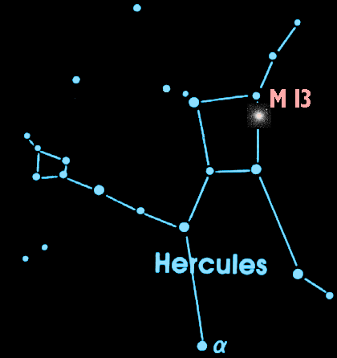
M13 is in the Night Sky
A dark night and a good pair of binoculars can help you catch a glimpse of this cluster of stars in the constellation Hercules.

Slide 4
What is M13?
M13 is a globular cluster over 150 light years across and it contains about 1,000,000 stars.

Slide 5
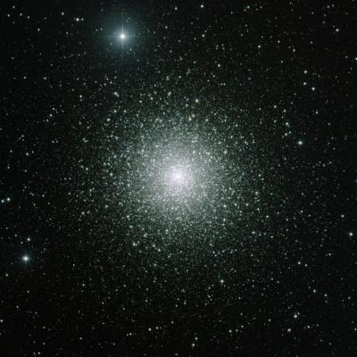
What is a Globular Cluster?
A globular cluster is a tightly packed group of about 100,000 stars. There are roughly 150-200 globular clusters in the Milky Way.

Slide 6
How Big are Globular Clusters?
150 light years
M13 is 150 light years across. At the speed of light (186,000 mi/sec) it takes 150 years for light to cross M13 from one side to the other. – That’s 2 lifetimes!

Slide 7
How Old Are Globular Clusters?
The globular clusters of our Milky Way are old! They are the same age as the galaxy itself – at least 12 billion years old.

Slide 8
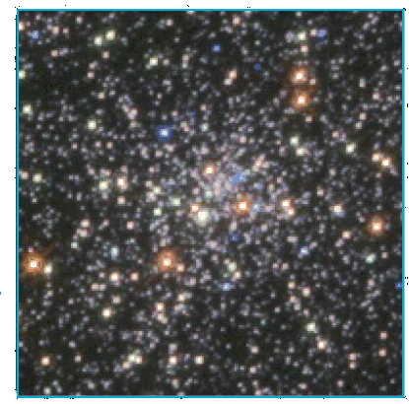
Young Stars in Old Clusters
This HST image reveals blue stars in a globular cluster's core.
Blue Stars do not live long. Globular clusters are old and generally do not have blue stars.
These blue stars may have been formed by
the collisions of old stars!

Slide 9
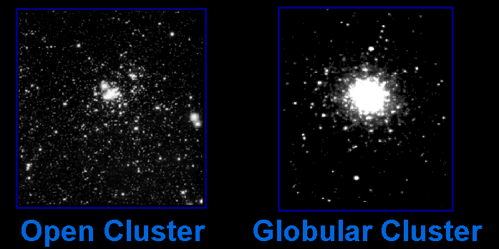
Star Clusters
There are two main types of star clusters in our Milky Way galaxy

Slide 10
Star Clusters
Star Clusters
Open clusters orbit within the disk of the galaxy while Globular clusters orbit above and below the plane of the galaxy in the galactic halo.

Slide 11
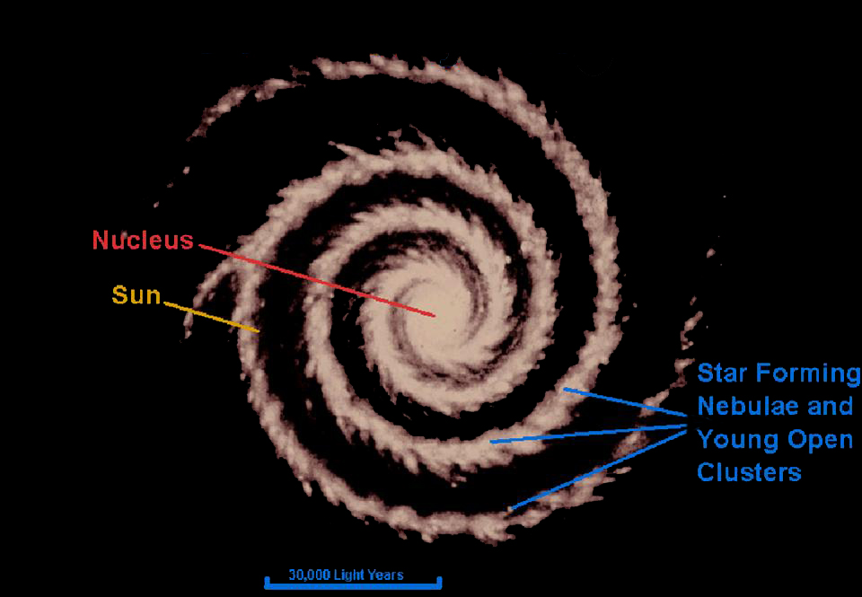
Our Milky Way Galaxy
(top view)

Slide 12
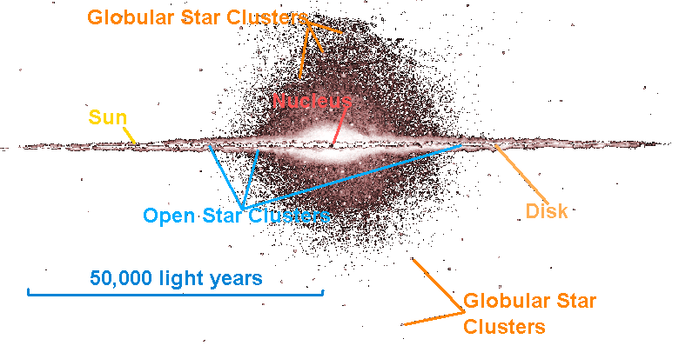
Our Milky Way Galaxy
(side view)

Slide 13
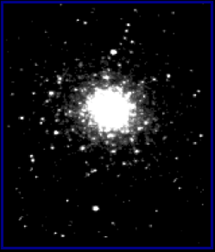

The Star Clusters Are Actually Different Sizes
Open Cluster
Globular Cluster
Open clusters are about 30 light years across.
Globular clusters are about 150 light years across.
Open clusters are 5 times smaller than globular clusters. They only look the same size because they are closer.

Slide 14
The Star Clusters Are Actually Different Sizes
Open Cluster
Globular Cluster
Open clusters have hundreds to thousands of stars.
Globular clusters have thousands to nearly a million stars.

Slide 15
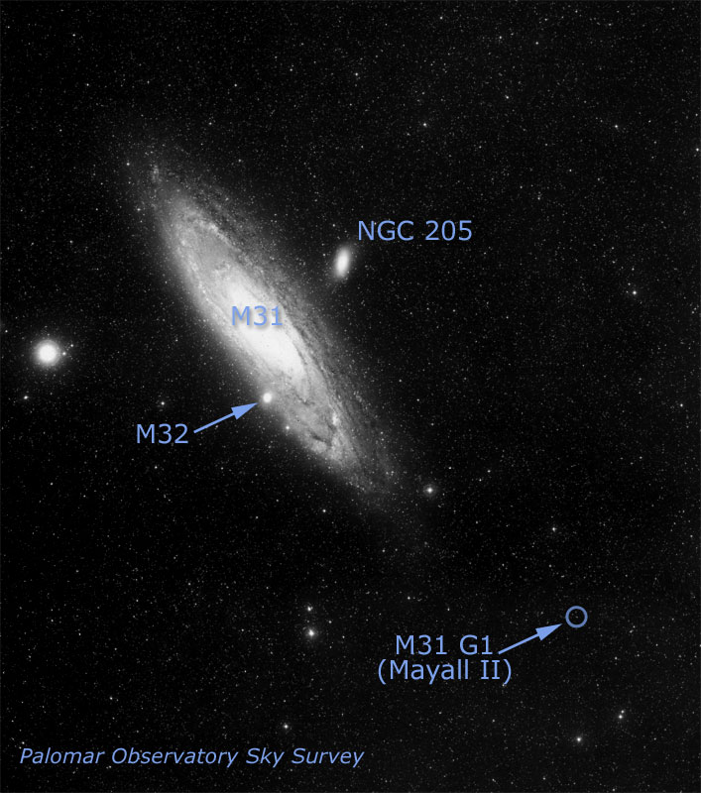
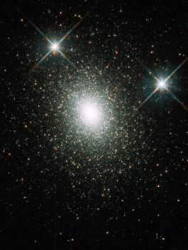
Other Galaxies Have Halos of Globular Clusters
HST image of G1
This globular cluster called G1 is in the halo of the Andromeda galaxy (M31).
This globular has a medium-sized black hole in it!

Slide 16
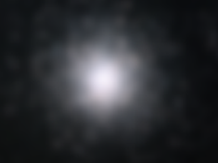
Charles Messier & M13
Charles Messier recorded M13 on June 1, 1764 and described it as follows:
“A nebula (gas cloud) without stars, discovered in the belt of Hercules; it is round and brilliant, the center [is] more brilliant than the edges.”
What Charles probably saw.

Slide 17
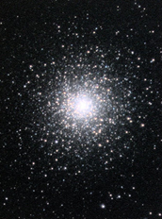
Charles Messier & M13
M13 was discovered by Edmond Halley in 1714.
Twenty-eight of the 110 objects in Messier’s catalog are globular clusters.

